Slide 1


The basic components of the Provengo Modelling Language
Notes:
Hello. In this video, we introduce the basic components of Provengo’s modelling language and show how these building blocks can be effectively utilized to architect independent modules tailored for each requirement.

Slide 2
bthread("name1", function () {
sync({request: Event("A")})
sync({request: Event("A")})
sync({request: Event("A")})
})
bthread("name2", function () {
sync({request: Event("B")})
sync({request: Event("B")})
sync({request: Event("B")})
})
We want to have three “A” events in our run
We want to have three “B” events in our run
Notes:
Provengo models are made up of behavioral threads, each one outlining a requirement. In this specific case, we observe two behaviors that represent our need for three instances of the ‘A’ and ‘B’ events.

Slide 3
bthread("name1", function () {
sync({request: Event("A")})
sync({request: Event("A")})
sync({request: Event("A")})
})
bthread("name2", function () {
sync({request: Event("B")})
sync({request: Event("B")})
sync({request: Event("B")})
})
A
B
A
B
A
B
A
B
A
B
A
B
B
A
B
A
B
A
B
A
B
A
B
A
Notes:
The interpretation of this model can be illustrated through a graph. A single execution of the model is a path from the topmost point down to the bottom.

Slide 4
bthread("name1", function () {
sync({request: Event("A")})
sync({request: Event("A")})
sync({request: Event("A")})
})
bthread("name2", function () {
sync({request: Event("B")})
sync({request: Event("B")})
sync({request: Event("B")})
})
A
B
A
B
A
B
A
B
A
B
A
B
B
A
B
A
B
A
$ provengo run .
…
[RUN ] INFO Preparing to run
[RUN>random] INFO B-program started
[RUN>random] INFO Selected: [B]
[RUN>random] INFO Selected: [A]
[RUN>random] INFO Selected: [B]
[RUN>random] INFO Selected: [A]
[RUN>random] INFO Selected: [B]
[RUN>random] INFO Selected: [A]
[RUN ] INFO Test Result: SUCCESS
B
A
B
A
B
A
Notes:
When the model is executed, it produces a random sequence of events. The yellow line on the graph represents the path corresponding to these events.

Slide 5
bthread("name1", function () {
sync({request: Event("A")})
sync({request: Event("A")})
sync({request: Event("A")})
})
bthread("name2", function () {
sync({request: Event("B")})
sync({request: Event("B")})
sync({request: Event("B")})
})
A
B
A
B
A
B
A
B
A
B
A
B
B
A
B
A
B
A
$ provengo run .
…
[RUN ] INFO Preparing to run
[RUN>random] INFO B-program started
[RUN>random] INFO Selected: [B]
[RUN>random] INFO Selected: [B]
[RUN>random] INFO Selected: [A]
[RUN>random] INFO Selected: [A]
[RUN>random] INFO Selected: [A]
[RUN>random] INFO Selected: [B]
[RUN ] INFO Test Result: SUCCESS
B
A
B
A
B
A
Notes:
Each execution of the model results in the generation of a new random path.

Slide 6
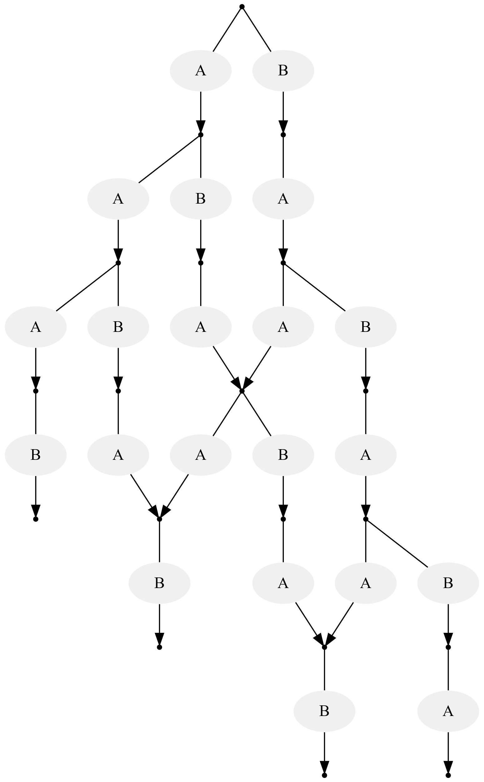
bthread("name1", function () {
sync({ request: Event("A") })
sync({ request: Event("A") })
sync({ request: Event("A") })
})
bthread("name2", function () {
sync({ request: Event("B") })
sync({ request: Event("B") })
sync({ request: Event("B") })
})
bthread("name3", function () {
while(true) {
sync({ waitFor: Event("B") })
sync({ waitFor: Event("A"), block: Event("B") })
}
})
Don’t generate two “B” in a row
Notes:
But this is not all! Sync statements are multifunctional. They can request events, wait for specific events, and even block events. This adaptability enables us to enforce constraints. For instance, we can avoid two ‘B’ events consecutively. The execution process operates by choosing an event at each synchronization point. The selected event must be requested and not blocked. Note that the paths from the top to the bottom in the revised graph remain the same as in the previous graph, except for the paths that contain two ‘B’ events consecutively. The execution comes to a halt when there’s no event that is both requested and unblocked.

Slide 7
Dry run
bthread("name1", function () {
sync({ request: Event("A") })
sync({ request: Event("A") })
sync({ request: Event("A") })
})
bthread("name2", function () {
sync({ request: Event("B") })
sync({ request: Event("B") })
sync({ request: Event("B") })
})
bthread("name3", function () {
while(true) {
sync({ waitFor: Event("B") })
sync({ waitFor: Event("A"), block: Event("B") })
}
})
Notes:
Let’s conduct a dry run of the model to improve our understanding of the semantics. We initiate the process with the instruction pointer positioned at the first ‘sync’ statement of each b-thread, and the marker is placed at the uppermost node of the graph. Currently, the “A” and the “B” events are requested, and none is blocked.

Slide 8
bthread("name1", function () {
sync({ request: Event("A") })
sync({ request: Event("A") })
sync({ request: Event("A") })
})
bthread("name2", function () {
sync({ request: Event("B") })
sync({ request: Event("B") })
sync({ request: Event("B") })
})
bthread("name3", function () {
while(true) {
sync({ waitFor: Event("B") })
sync({ waitFor: Event("A"), block: Event("B") })
}
})
Notes:
Assume, for example, that “B” is chosen. Following this, the second b-thread, which had requested this event, and the third b-thread, which had been waiting for it, both progress to their subsequent synchronization points. At this stage, requests have been made for both events, and “B” is now blocked. Consequently, the only event that can be activated is “A”.

Slide 9
bthread("name1", function () {
sync({ request: Event("A") })
sync({ request: Event("A") })
sync({ request: Event("A") })
})
bthread("name2", function () {
sync({ request: Event("B") })
sync({ request: Event("B") })
sync({ request: Event("B") })
})
bthread("name3", function () {
while(true) {
sync({ waitFor: Event("B") })
sync({ waitFor: Event("A"), block: Event("B") })
}
})
Notes:
The first b-thread, which had requested “A”, and the third b-thread, which had been waiting for it, both advance. W find ourselves, again, in a state where either of the two events can be activated.

Slide 10
bthread("name1", function () {
sync({ request: Event("A") })
sync({ request: Event("A") })
sync({ request: Event("A") })
})
bthread("name2", function () {
sync({ request: Event("B") })
sync({ request: Event("B") })
sync({ request: Event("B") })
})
bthread("name3", function () {
while(true) {
sync({ waitFor: Event("B") })
sync({ waitFor: Event("A"), block: Event("B") })
}
})
Notes:
Let’s assume that ‘A’ is selected. In this case, only the bthread, that made the request proceeds. We are, again, in a state where both events can be triggered.

Slide 11
bthread("name1", function () {
sync({ request: Event("A") })
sync({ request: Event("A") })
sync({ request: Event("A") })
})
bthread("name2", function () {
sync({ request: Event("B") })
sync({ request: Event("B") })
sync({ request: Event("B") })
})
bthread("name3", function () {
while(true) {
sync({ waitFor: Event("B") })
sync({ waitFor: Event("A"), block: Event("B") })
}
})
Notes:
Say that “B” is selected and the bthreads advance accordingly. Now, only “A” can be triggered.

Slide 12
bthread("name1", function () {
sync({ request: Event("A") })
sync({ request: Event("A") })
sync({ request: Event("A") })
})
bthread("name2", function () {
sync({ request: Event("B") })
sync({ request: Event("B") })
sync({ request: Event("B") })
})
bthread("name3", function () {
while(true) {
sync({ waitFor: Event("B") })
sync({ waitFor: Event("A"), block: Event("B") })
}
})
Notes:
After the next “A”, the first bthread ends. In this case, the bthread is dropped and the other bthreads continue without it.

Slide 13
bthread("name1", function () {
sync({ request: Event("A") })
sync({ request: Event("A") })
sync({ request: Event("A") })
})
bthread("name2", function () {
sync({ request: Event("B") })
sync({ request: Event("B") })
sync({ request: Event("B") })
})
bthread("name3", function () {
while(true) {
sync({ waitFor: Event("B") })
sync({ waitFor: Event("A"), block: Event("B") })
}
})
Notes:
When there is no more events that are requested and not blocked, the run of the model terminates.

Slide 14
Notes:
This concludes our lesson. We have learned what are bthreads and how they use sync to synchronize the selection of a sequence of events.

